Slide 1
Data Engineering Consultancy with Cloud Data Platforms
Chris Hastie, InterWorks

Slide 2
Who Am I?
2014 : Graduated with a Masters in Maths, First
University of Manchester
2014 – 2015 : Analyst, 2015 – 2017 : Senior Analyst
BravoSolution, a company specialising in sourcing and procurement analytics
2017+ : Data Engineering and Analytics Consultant
InterWorks
https://www.linkedin.com/in/chris-hastie/

Slide 3
Who Am I?
6 years working professionally with data
Warehousing, transformation and analysis
5 years working professionally with Tableau
DataDev Ambassador
2 years working professionally with Snowflake
Data Superhero
https://www.linkedin.com/in/chris-hastie/

Slide 4
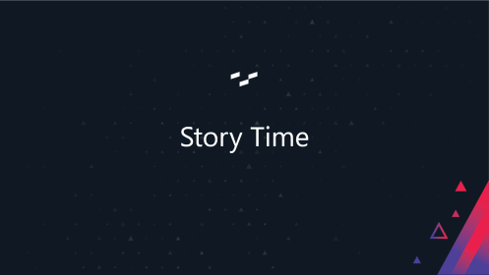
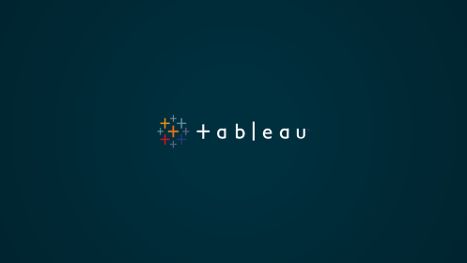

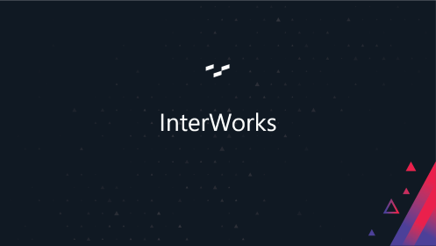
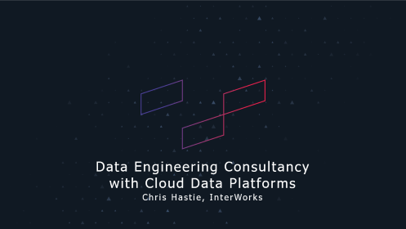

Agenda

Slide 5
InterWorks

Slide 6
Notes:
Further locations:
Germany
Netherlands
Switzerland

Slide 7
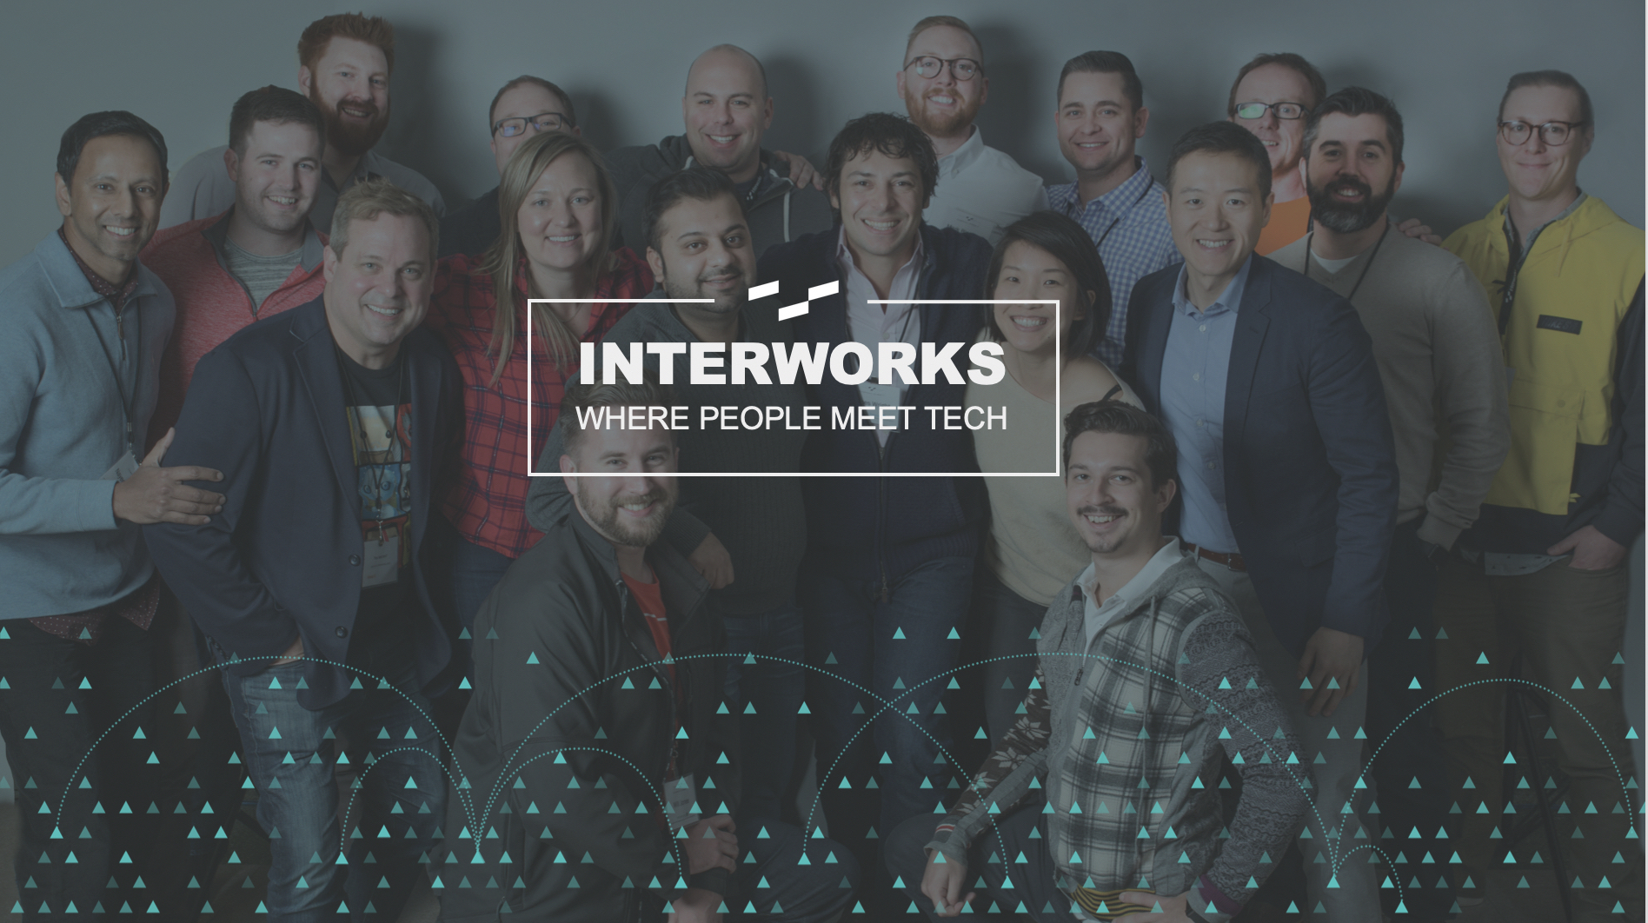
Notes:
Interworks is where people meet technology

Slide 8
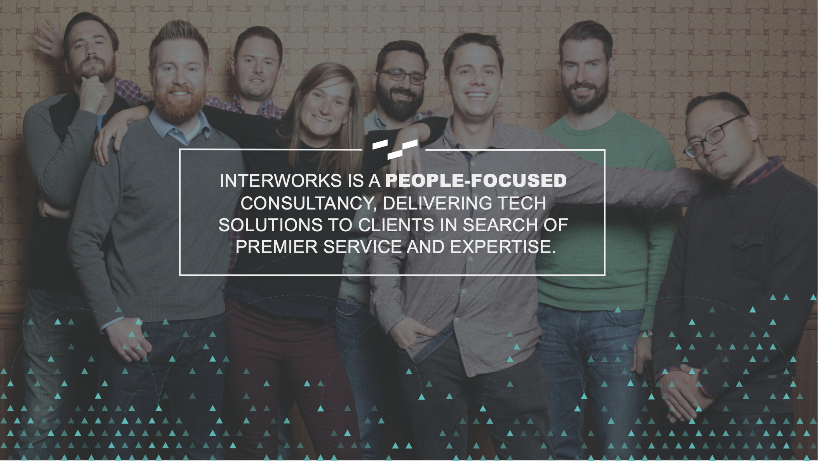

Slide 10















WHO WE ARE
SOME QUICK BRAGS
First Tableau Gold Partner
Tableau Partner of the Year (US, EMEA & APAC)
Snowflake Partner of the Year
Inc. 5000 Fastest-Growing Private Companies
From foundation to vision, InterWorks is at every juncture of people and tech. What we do matters, but the way in which we do it defines us. By hiring the brightest minds, aligning ourselves with savvy partners and empowering clients at every turn, we help others do more and strengthen their bond with the larger tech community.
CLIENTS
We’ve worked with some of the world’s most recognizable organizations. Here are just a few:
We’ve worked with some of the world’s most recognizable organizations. Here are just a few:

Slide 11







Our Partners

Slide 12
InterWorks

Slide 13


Slide 14


DATA PLATFORM BUILT FOR THE CLOUD
Complete SQL Database
Zero Management
All of Your Data
All of Your Users
Pay Only for What You Use
Live Data Sharing

Slide 15
SCALE ON-DEMAND
Traditional databases are inflexible
Snowflake uses the cloud
to enable elasticity
Usage
varies
Time
Pay for only what you use with no overprovisioning
Eliminate
overbuy
Scale compute up and down, transparently and automatically
No need for capacity planning, make capacity decisions on the fly

Slide 16
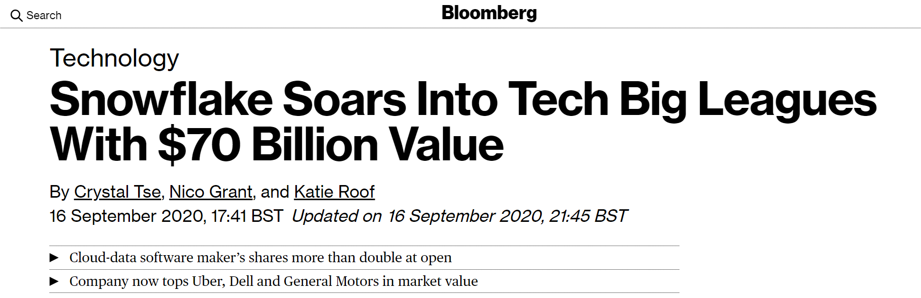
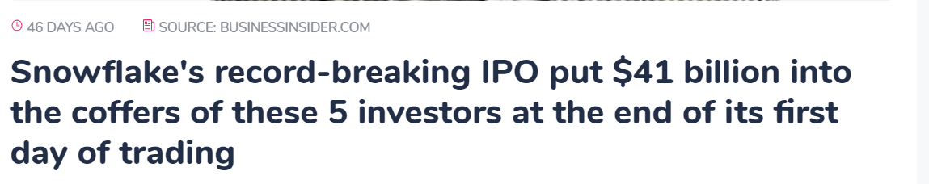
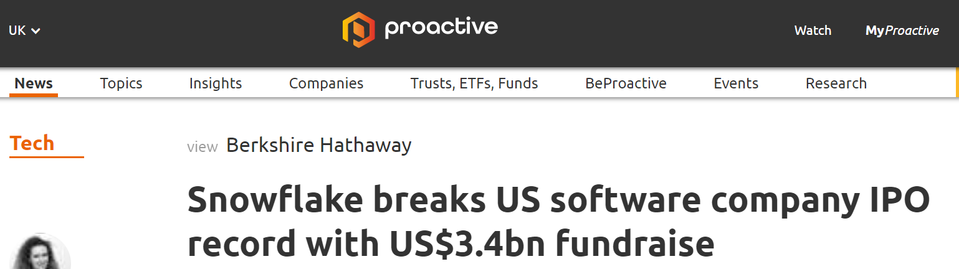
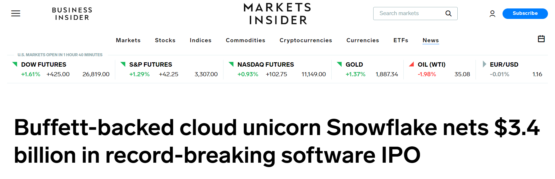
RECORD-BREAKING IPO

Slide 17
SNOWFLAKE’S MULTI-CLUSTER SHARED DATA ARCHITECTURE
Transactions
Security
Management
Ad hoc analytics
Centralized storage
Development
Service
Loading
Meta data
Compute
Optimization
Storage
Instant, automatic scalability & elasticity

Slide 18
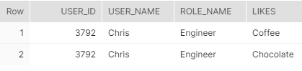
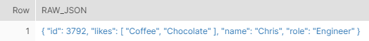
Semi-structured data
SELECT
raw_json:id::int as user_id
, raw_json:name::text as user_name
, raw_json:role::text as role_name
, value::text as likes
FROM raw_data,
lateral flatten (
input => raw_json,
path => 'likes’
);
{
“name” : “Chris”,
“id” : 3794,
“role” : “Engineer”,
“likes” : [
“Coffee”,
“Chocolate”
]
}
Notes:
JSON
Parquet
ORC

Slide 19

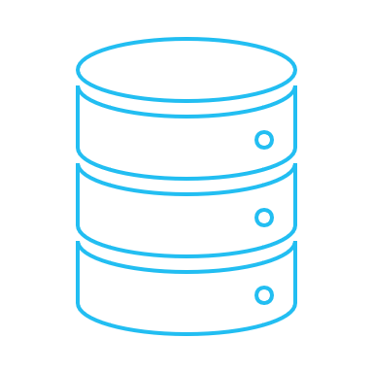

Time travel
UNDROP table | schema | database
SELECT from ... at | before
-90 days
now

Slide 20








Data Sharing
Provider
Consumer

Slide 22


Slide 23

Notes:
ADDED “CLICK” to talk track

Slide 24


Slide 25
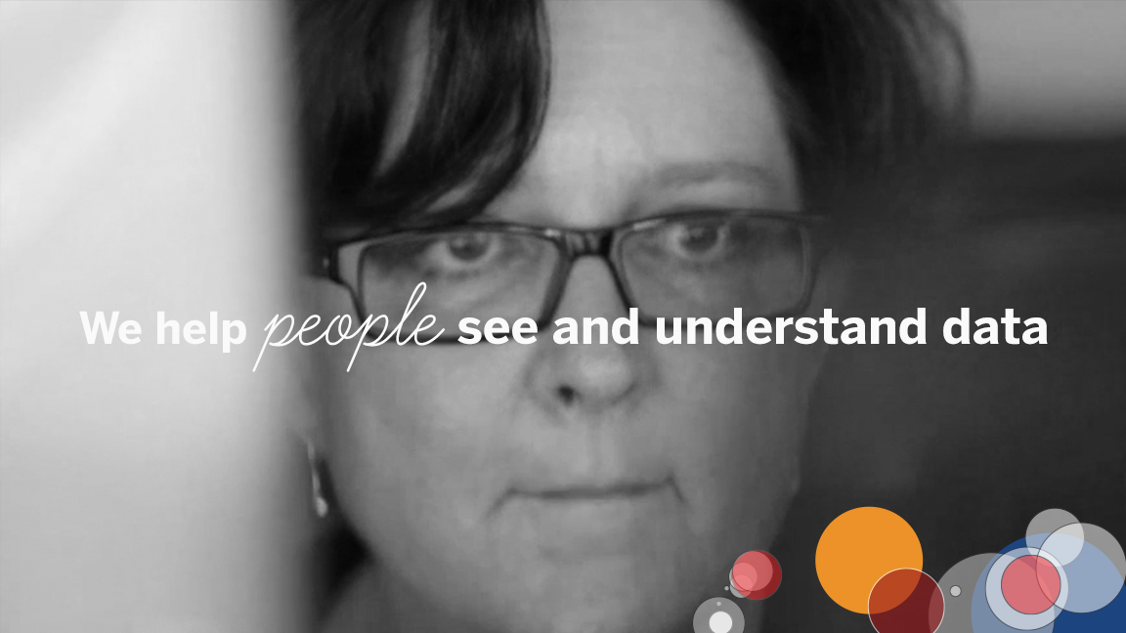


Slide 26
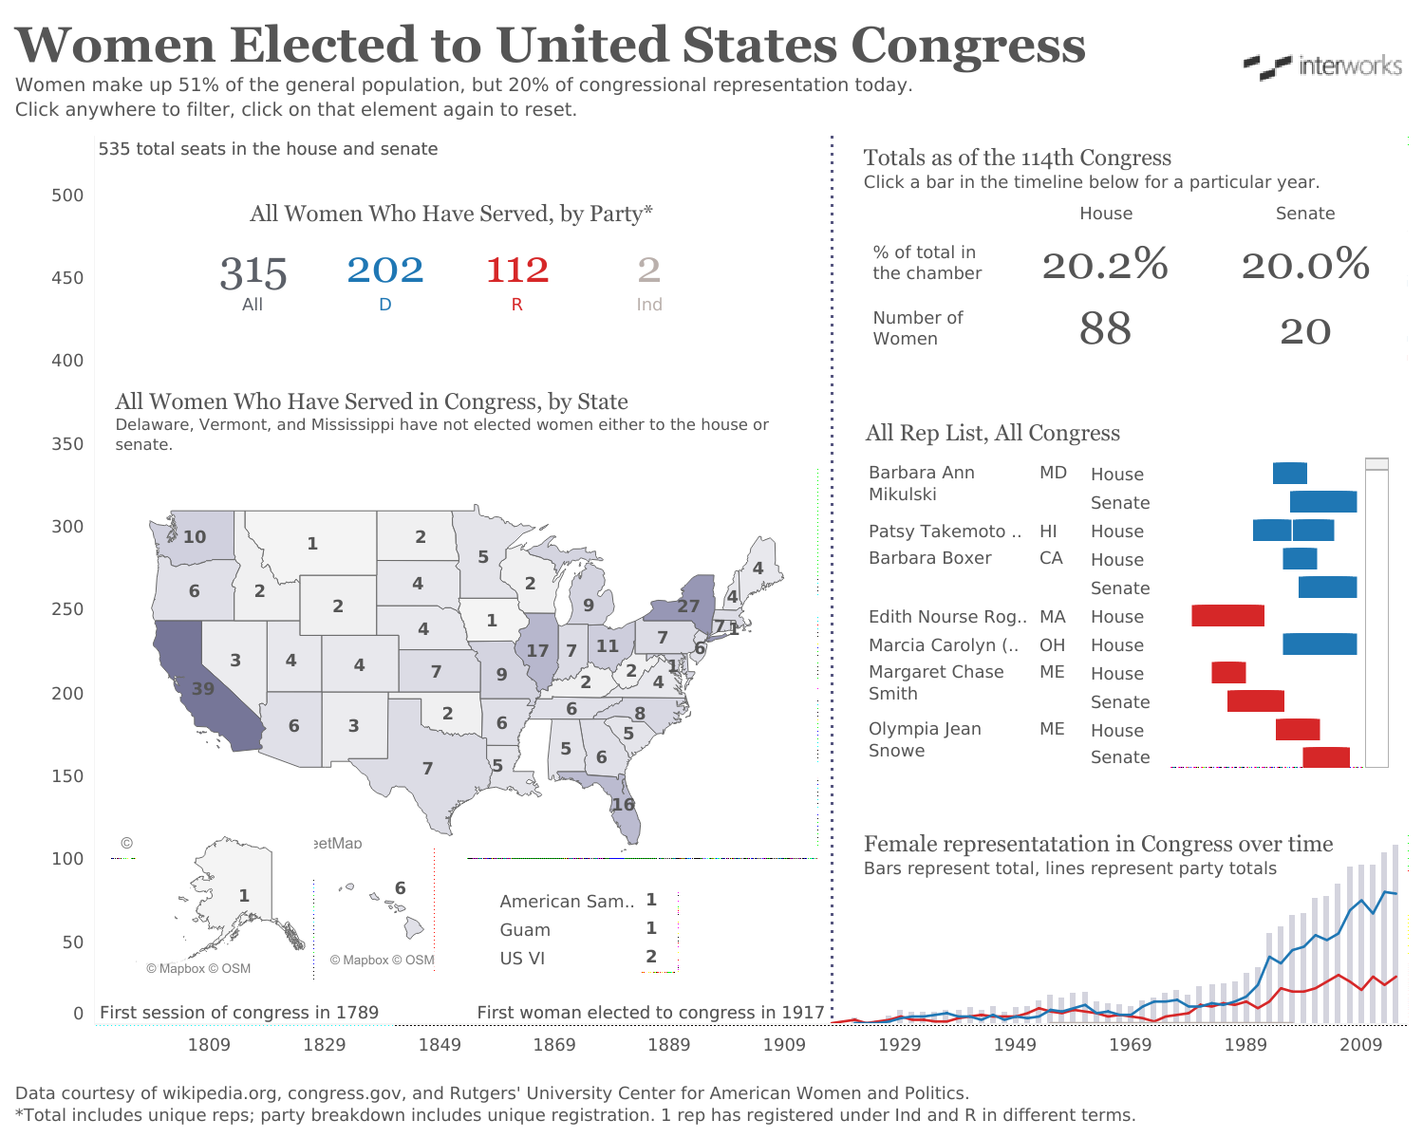
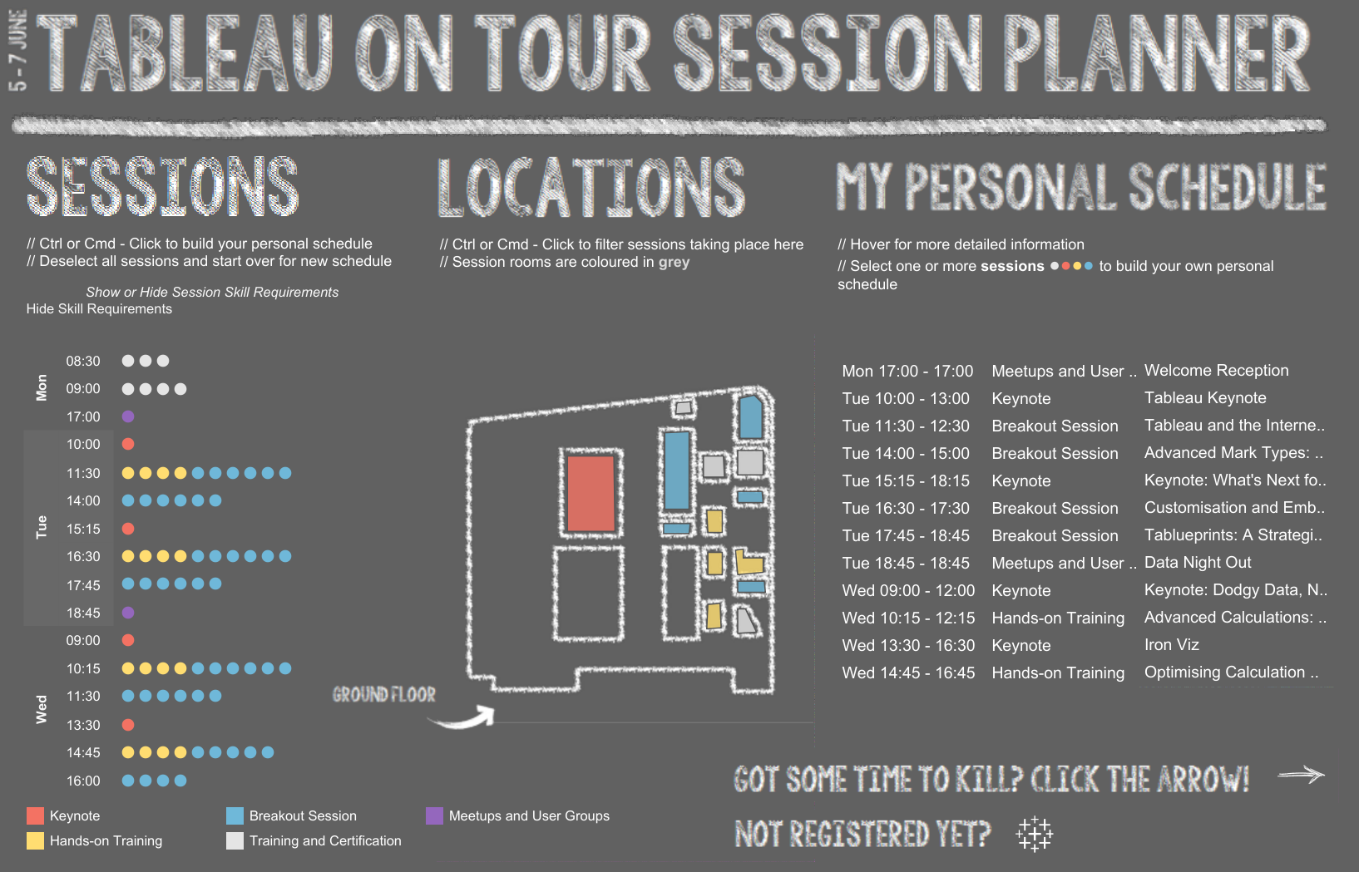
TABLEAU VIZZES
InterWorks
InterWorks

Slide 27
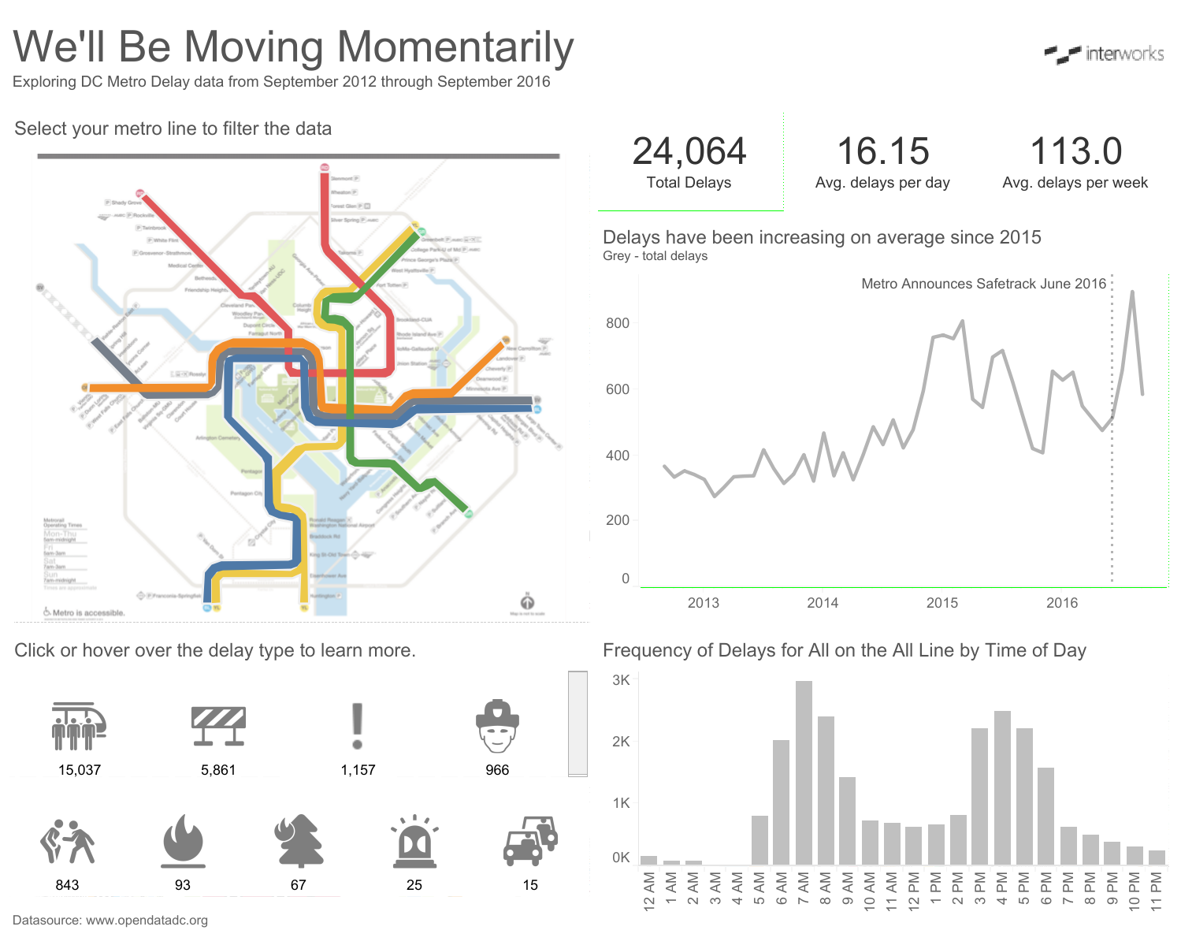
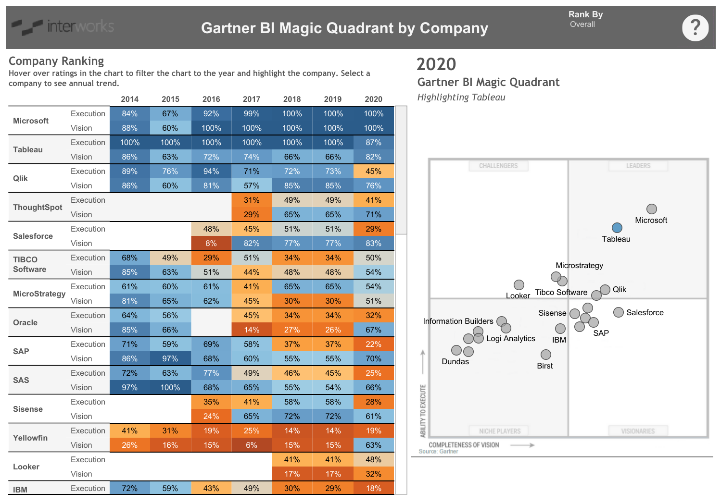
TABLEAU VIZZES
InterWorks
InterWorks

Slide 28
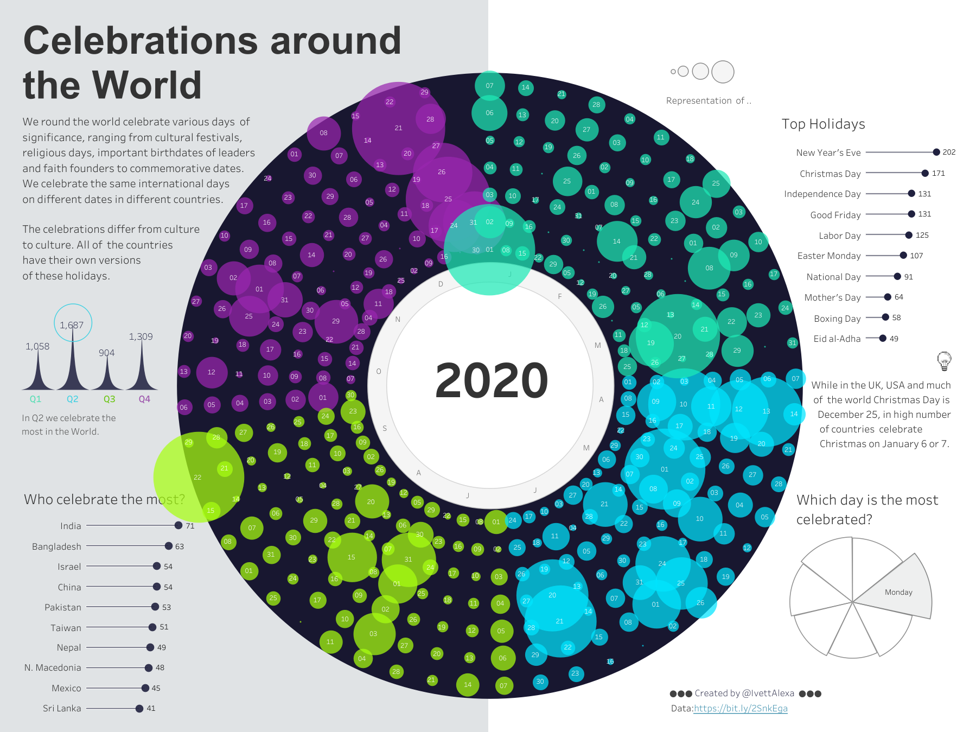
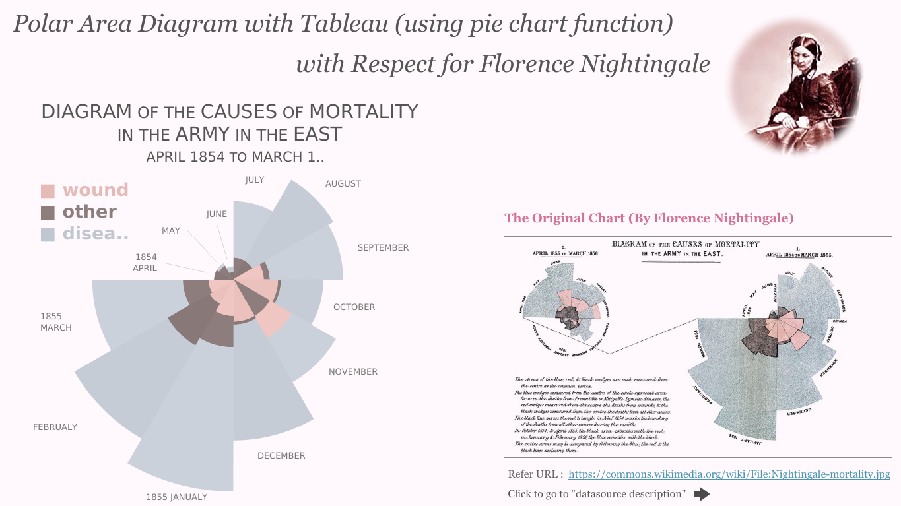
TABLEAU VIZZES
Satoshi Ganeko
Ivett Alexa

Slide 30
Story Time

Slide 31











Example Solution Architecture
External Booking
System
Blob Storage
Master Table
Initial Transformation Process
Analytics Schema
Tableau
dashboards
Change
Management
Stream
Task
Every 15
Minutes
Stored Procedure
Notes:
Derek Hecksher recently wrote a blog running through a very similar stored procedures and tasks setup.

Slide 32






Rough S3 Snowpipe Data Workflow
Snowflake awaits a notification from AWS that new files are in S3
Snowflake then pulls the data from the S3 bucket(s)
This process is documented here and will require AWS admin access or a member of the client team
SNS Notification
Snowflake
services layer
Source files
Upload tool
S3 Storage
Load request
By Snowflake
Data pull
by Snowflake
Snowflake
landing tables
Transformation
Process
Analytics Schema
In Snowflake
Tableau
dashboards

Slide 33







AWS IAM
Resource policy confirms
authorisation for API access
AWS API Gateway
Snowflake
SUM
external function
SUM
Function Stage
SUM
Function Resource
SUM
Function
Snowflake-defined API call with JSON input data as body
API call body passed to AWS Lambda function, including JSON input data
PRODUCT
external function
API response with JSON output data as body
PRODUCT
Function Stage
PRODUCT
Function Resource
AWS Lambda output passed back, including JSON output data in Snowflake-desired format
PRODUCT
Function
API call
external function
API Call
Function Stage
API Call
Function Resource
API Call
Function
External
API

Slide 34
Mistakes I’ve Made
Don’t just run things and see what happens
Know how to undo whatever you do
Test test test
Never dismiss anybody
Don’t put things off
Be prepared to do a lot of boring things
Be prepared to go outside your expected role
Remember you represent more than yourself
Make sure you enjoy your actual work
Be honest with your manager

Slide 35
Corporation vs SME
Big name
CV
Morale
Social boast
Established
Documentation
Training
Clear roles
Clear progression
Compensation
Higher budget
Public scrutiny
Risk!
Freedom
Test new things
Learn new things
Create your role
Culture
Know everybody
Feel more valued
See your impact
Less bureaucracy
No red tape
Approachable management
Potential
Speed of change
Risk!
* These are generalisations and definitely do not apply to all companies!

Slide 36
Story Time

Slide 37
Thank you!

Slide 38
Thank you for listening
Want to get in touch with me directly?
https://www.linkedin.com/in/chris-hastie/
Interested in learning more about InterWorks?
https://interworks.com

